Slide 1
Python Functions & Advanced Concepts
Functions
Arguments & Returns
Scope
*args & **kwargs
Lambda Functions
Decorators

Slide 2
What is a Function?
A function is a reusable block of code
Helps avoid repetition
Makes code modular and readable

Slide 3
Why Use Functions?
Code reusability
Better organization
Easy debugging
Improves readability

Slide 4
Multiple Arguments in Function & Returning Multiple Values
Functions can take multiple inputs
Example:
A function can accept name, age, city
Values are passed in order (positional arguments)
----------------------------------------------------------
Python allows returning multiple values
Internally it returns a tuple
Example:
A function can return sum and difference together

Slide 5
Special Arguments (args & kwargs)
Used to pass multiple arguments dynamically
Stored as a tuple
Use case:
When number of inputs is unknown
--------------------------------------------------------------------------------
Used to pass key-value arguments
Stored as dictionary
Use case:
When data is in key-value format

Slide 6
Difference (*args vs kwargs)
*args → multiple values (tuple)
**kwargs → key-value pairs (dictionary)

Slide 7
Lambda Function
Anonymous (no name) functions
Written in one line
Syntax:
lambda arguments: expression
Why Lambda?
Short & concise
Used for small operations
Often used with:
map()
filter()
sorted()

Slide 8
Introduction to Decorators
Decorators modify behavior of functions
They wrap another function
Used for:
logging
authentication
performance tracking Function inside a function
Return a new function
👉 “Functions are first-class citizens in Python”

Slide 9
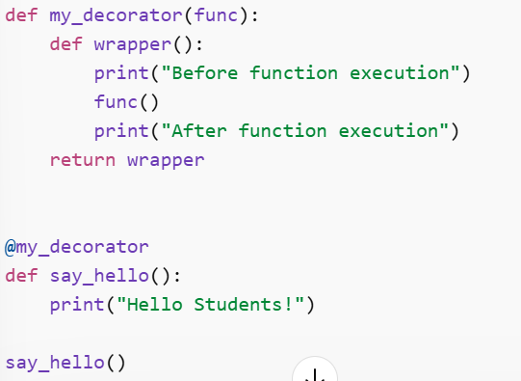
Decorator Code Example

